Slide 1

WEB UI Automation. Selenium
Vasilii Aleksandrov
11.2022

Slide 2
AGENDA
Why Selenium?
Base of Selenium and WebDriver
WebDriver setup
How to find an element from a Web page
Basic WebDriver’s methods
Waits
Interacting with the page
Screenshots

Slide 3

Why Selenium?
Most popular UI testing tool
Every OS, Browser and Platform
Open Source
Large Community
Very flexible to operate with any UI
Support Multithreading

Slide 4
Base of Selenium and WebDriver

Slide 5
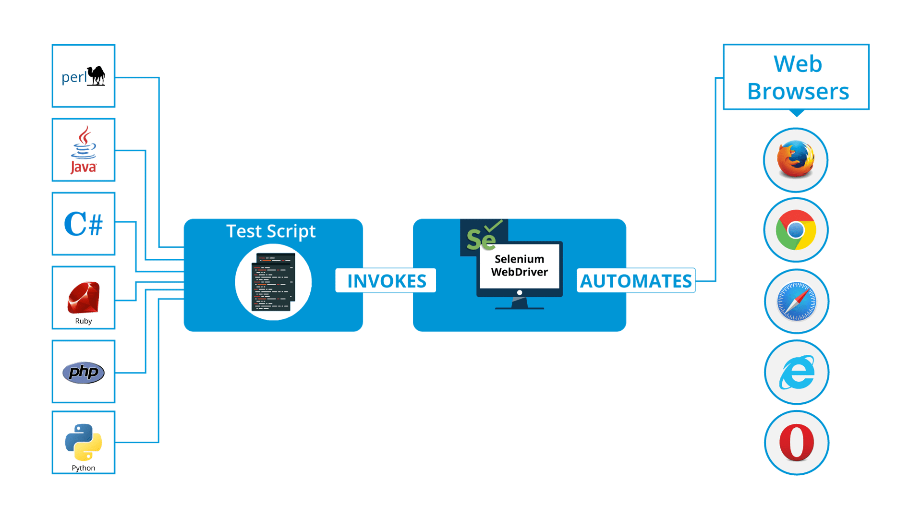
Selenium

Slide 6
Simple usage
from selenium import webdriver
driver = webdriver.Chrome()
# the instance of Chrome WebDriver is created
driver.get("http://epam.com")
# navigation to a page by URL
assert "EPAM | Enterprise Software Development, Design & Consulting" in driver.title
# an assertion to confirm that page title has this phrase in it
driver.close()
# the browser window is closed

Slide 7
WebDriver Setup

Slide 8
Getting started with different browsers
from selenium import webdriver
driver = webdriver.Chrome()
driver = webdriver.Firefox()
driver = webdriver.Safari()
driver = webdriver.Edge()
driver = webdriver.Ie()
driver = webdriver.Remote(remoteURL, capabilities)
driver.close()

Slide 9
WebDriver Options
from selenium import webdriver from selenium.webdriver.chrome.options import Options options = Options() options.add_argument("--disable-gpu") options.add_argument("--window-size=800,600") options.add_argument("--disable-notifications") options.add_argument("--mute-audio") options.add_argument("--headless")
driver = webdriver.Chrome(options=options)

Slide 10
Basic WebDriver’s methods

Slide 11
WebDriver Functions
from selenium import webdriver
driver = webdriver.Chrome()
url = "https://www.epam.com/" title = "Some weird title" expected_source = "https://www.google-analytics.com/analytics.js" driver.get(url) assert url == driver.current_url assert title != driver.title assert expected_source in driver.page_source driver.close() # driver.quit()
driver.close() – close current browser window
driver.quit() – close all opened browser windows

Slide 12
WebDriver Navigation and Moving between windows and frames
from selenium import webdriver
driver.get(“some url”)
driver.forward()
driver.back()
driver.refresh()
driver.switch_to.window(“windowName”)
driver.switch_to.frame(“frameName”)
driver.switch_to.new_window()
driver.switch_to.alert
driver.switch_to.default_content()

Slide 13
How to find Web Elements

Slide 14
Locating Web Elements
from selenium import webdriver
from selenium.webdriver.common.by import By
driver.find_element(By.XPATH, '//button[text()="Some text"]')
# to find one element
driver.find_elements(By.XPATH, '//button')
#to find multiple elements (these methods will return a list)

Slide 15
Strategies to locate Web Elements
from selenium import webdriver
from selenium.webdriver.common.by import By
driver.find_element(By.ID, 'ID')
driver.find_element(By.NAME, 'NAME')
driver.find_element(By.XPATH, 'XPATH')
driver.find_element(By.LINK_TEXT, 'LINK_TEXT')
driver.find_element(By.PARTIAL_LINK_TEXT, 'PARTIAL_LINK_TEXT')
driver.find_element(By.TAG_NAME, 'TAG_NAME')
driver.find_element(By.CLASS_NAME, 'CLASS_NAME')
driver.find_element(By.CSS_SELECTOR, 'CSS_SELECTOR')

Slide 16
Waits

Slide 17
Waits types
Implicit wait
An implicit wait tells WebDriver to poll the DOM for a certain amount of time when trying to find any element (or elements) not immediately available. The default setting is 0. Once set, the implicit wait is set for the life of the WebDriver object.
Explicit wait
An explicit wait is a code you define to wait for a certain condition to occur before proceeding further in the code. The extreme case of this is time.sleep(), which sets the condition to an exact time period to wait.

Slide 18
Implicit wait
from selenium import webdriver
from selenium.webdriver.common.by import By
driver = webdriver.Chrome()
driver.implicitly_wait(10) # in seconds
driver.get('some loading url')
dynamicElement = driver.find_element(By.ID, 'dynamicElementID')

Slide 19
Explicit wait
from selenium import webdriver
from selenium.webdriver.common.by import By
from selenium.webdriver.support.ui import WebDriverWait
from selenium.webdriver.support import expected_conditions as EC
driver = webdriver.Chrome()
driver.get('some loading url')
try:
element = WebDriverWait(driver, 10).until( EC.presence_of_element_located((By.ID, 'dynamicElementID')))
)
finally:
driver.quit()

Slide 20
Expected Conditions
title_is
title_contains
presence_of_element_located
visibility_of_element_located
visibility_of
presence_of_all_elements_located
text_to_be_present_in_element
text_to_be_present_in_element_value
frame_to_be_available_and_switch_to_it
invisibility_of_element_located
element_to_be_clickable
element_to_be_selected
element_located_to_be_selected
element_selection_state_to_be
element_located_selection_state_to_be
alert_is_present

Slide 21
Custom wait condition
class element_has_css_class(object): def __init__(self, locator, css_class): self.locator = locator self.css_class = css_class def __call__(self, driver): element = driver.find_element(*self.locator) # Finding the referenced element if self.css_class in element.get_attribute('class'): return element else: return False # Wait until an element with id='myElementID' has class 'myCSSClass' wait = WebDriverWait(driver, 10) element = wait.until(element_has_css_class((By.ID, 'myElementID'), 'myCSSClass'))

Slide 22
Interacting with the page

Slide 23
Interactions with elements
input some text into a text filed
element.send_keys("some text")
from selenium.webdriver import Keys
element.send_keys(" and some", Keys.ARROW_DOWN)
element.clear()
select elements
from selenium.webdriver.support.ui import Select
select = Select(driver.find_element(By.NAME, 'name'))
select.select_by_index(index)
select.select_by_visible_text("text")
select.select_by_value(value)
click elements
element.click()
drag and drop
from selenium.webdriver import ActionChains action_chains = ActionChains(driver) action_chains.drag_and_drop(element, target).perform()

Slide 24
Screenshots

Slide 25
Making screenshots
from selenium import webdriver driver = webdriver.Chrome() driver.get('http://www.python.org/') driver.save_screenshot('screenshot.png') driver.quit()

Slide 26

Useful links
https://selenium-python.readthedocs.io/
https://www.selenium.dev/documentation/

Slide 27



Questions
Vasilii_Aleksandrov@epam.com
VAleksandrov91

